Slide 1
Types Of Expenses
By: ReJon Barksdale

Slide 2
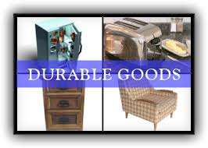
Durable Goods
goods not for immediate consumption and able to be kept for a period of time.
Examples of consumer durable goods include cars, household goods (home appliances, consumer electronics, furniture, etc.), sports equipment, firearms, and toys.

Slide 3
Consumable Goods
Consumables are in contrast to durable goods. Consumables are products that consumers use recurrently, i.e., items which "get used up" or discarded.
A bag of chips

Slide 4
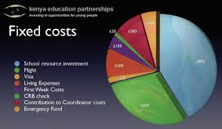
Fixed Expenses
A fixed expense is an expense that will be the same total amount regardless of changes in the amount of sales, production, or some other activity.
Insurance and rent

Slide 5
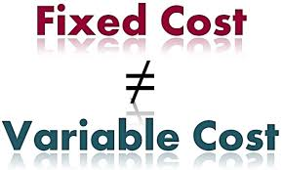
Variable or Flexible Expenses
Strictly variable costs are those that change directly with production. This makes such costs fixed per unit but variable in total.
Flexible costs, also called discretionary costs, are costs that are not committed to by the company.
if you produce candlestick holders, the brass used in production is a strictly variable cost. Advertisement

Slide 6
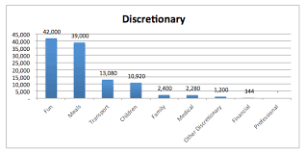
Discretionary Expenses
A discretionary expense is a cost which is not essential for the operation of a home or a business.
example, a business may allow employees to charge certain meal and entertainment costs to the company in order to promote goodwill with employees.

